Slide 1
Geography of Ukraine
The presentation was prepared by:
Saveliev A. A., Dean of the Educational Institute of Foreign Citizens Training
Kunitsyn M. V., Deputy Dean of the Educational Institute of Foreign Citizens Training

Slide 2
01
02
03
04
Geography of Ukraine
Miracles of Ukraine
Rivers and lakes in Ukraine
Climate in Ukraine

Slide 3
Geography of Ukraine

Slide 4
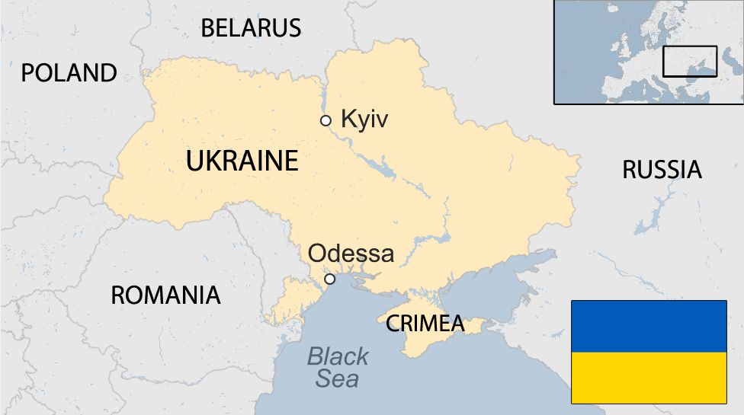
Ukraine on the world map
Ukraine is located in Eastern Europe.
The area of Ukraine is 603,700 square kilometers.
In the North, Ukraine borders Belarus.
In the west with Poland, Slovakia, Hungary.
In the southwest with Romania and Moldova.
In the east - with Russia.

Slide 5
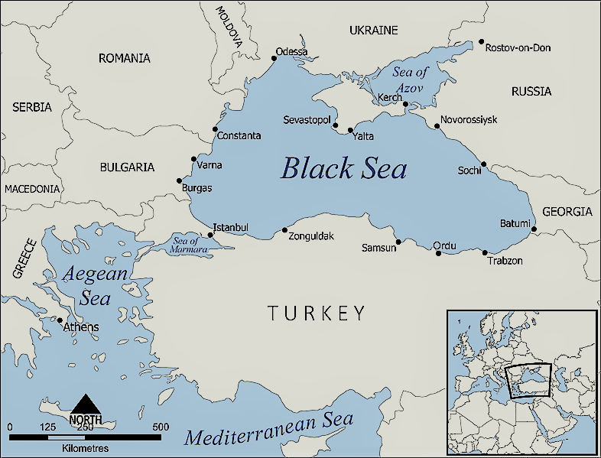
In the South, the territory of Ukraine is washed by the Black and Azov Seas.

Slide 6
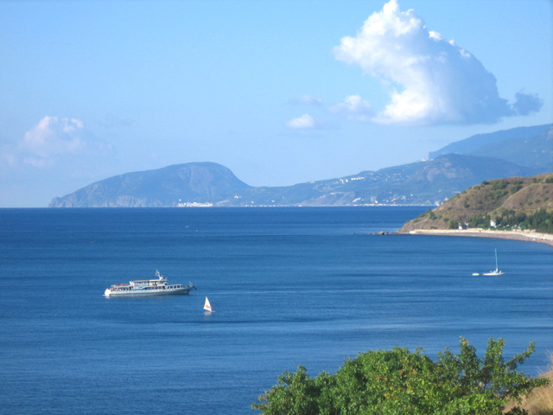
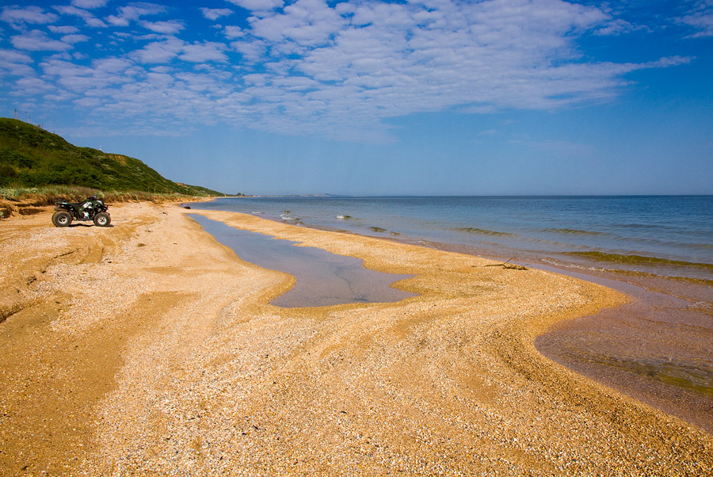
The area of the Sea of Azov is 37,800 sq. Km. The greatest depth is 13.5 meters.
The area of the Black Sea is 422,000 sq. Km.
The greatest depth is 2245 meters.

Slide 7
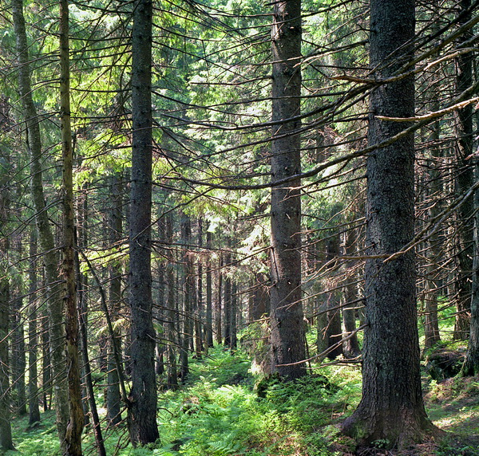
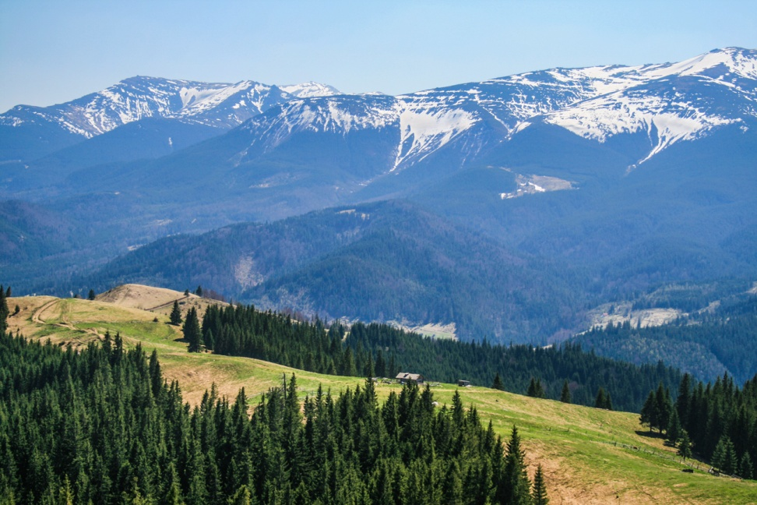
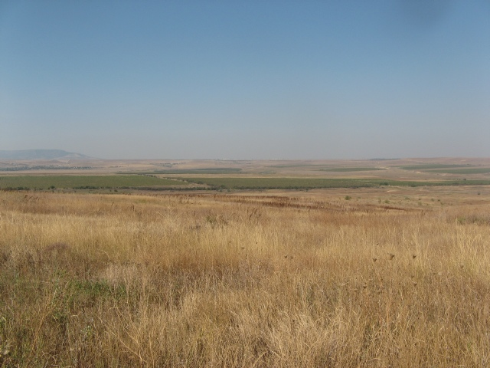
On the territory of Ukraine, there are mountains, forests, steppes.

Slide 8
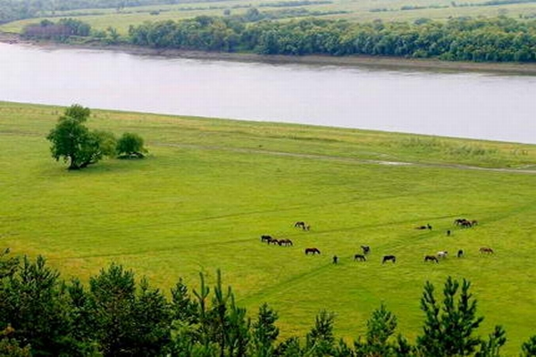
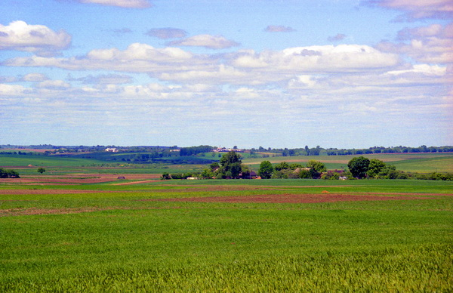
Most of Ukraine is flat (95%) with beautiful fertile land – chernozem.

Slide 9
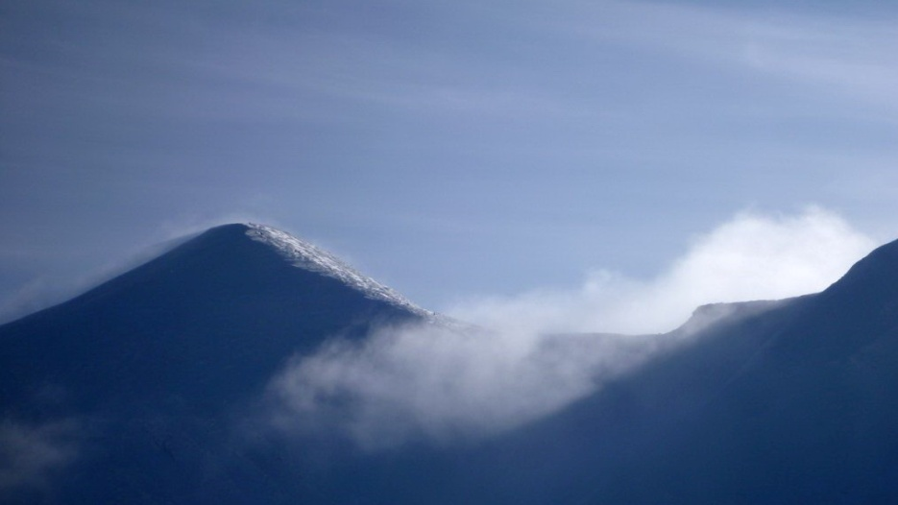
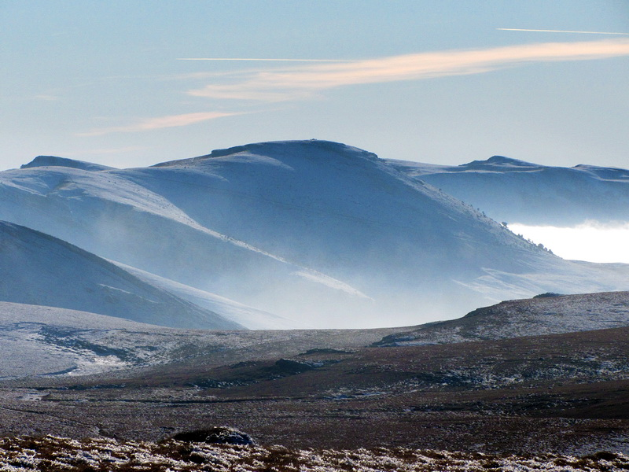
In the west are the hills - the Ukrainian Carpathians, in the South - the Crimean Mountains
The highest mountain in the Crimean mountains is Roman-Kosh. Its height is 1545 meters.
The highest mountain in the Ukrainian Carpathians is Hoverla. Its height is 2061 meters.

Slide 10
Miracles of Ukraine

Slide 11
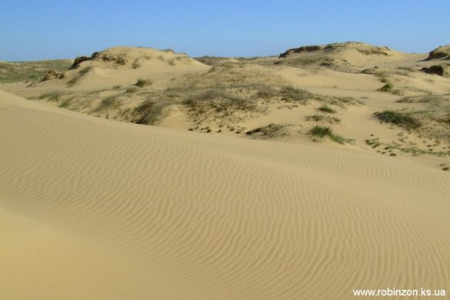
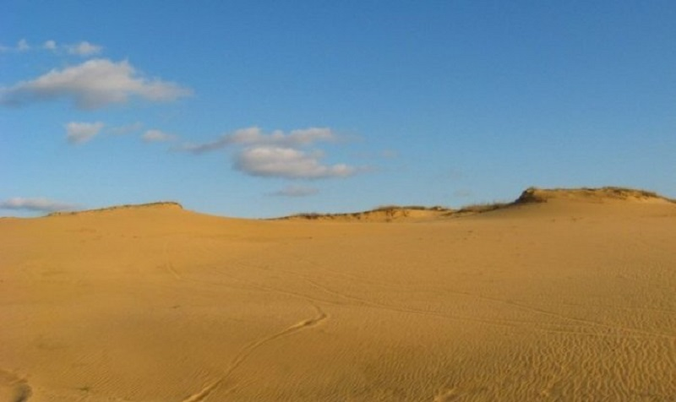
Oleshkiv desert
It is located 30 kilometers east of Kherson. Its area is 200 hectares. The desert appeared in the XIX century because the sheep destroyed all the grass in the area, leaving only the sands. Today, the Oleshkiv Desert is the enormous sand massif in Europe.

Slide 12
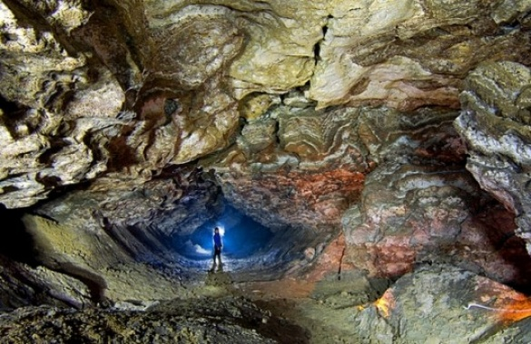
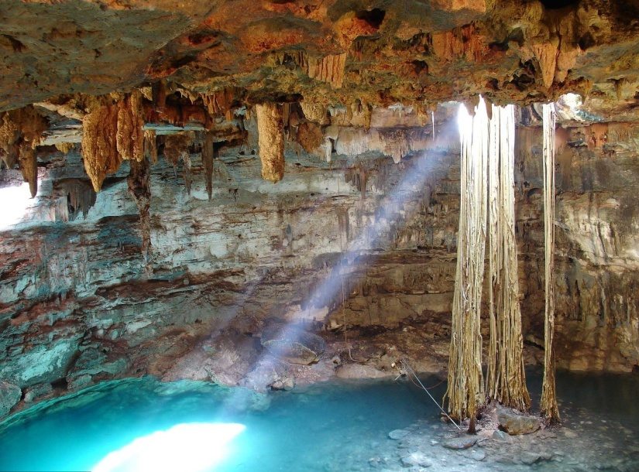
Optimistic cave
It is located in the west of Ukraine. The longest cave in Eurasia, the fifth in the world.

Slide 13
Rivers and lakes in Ukraine

Slide 14
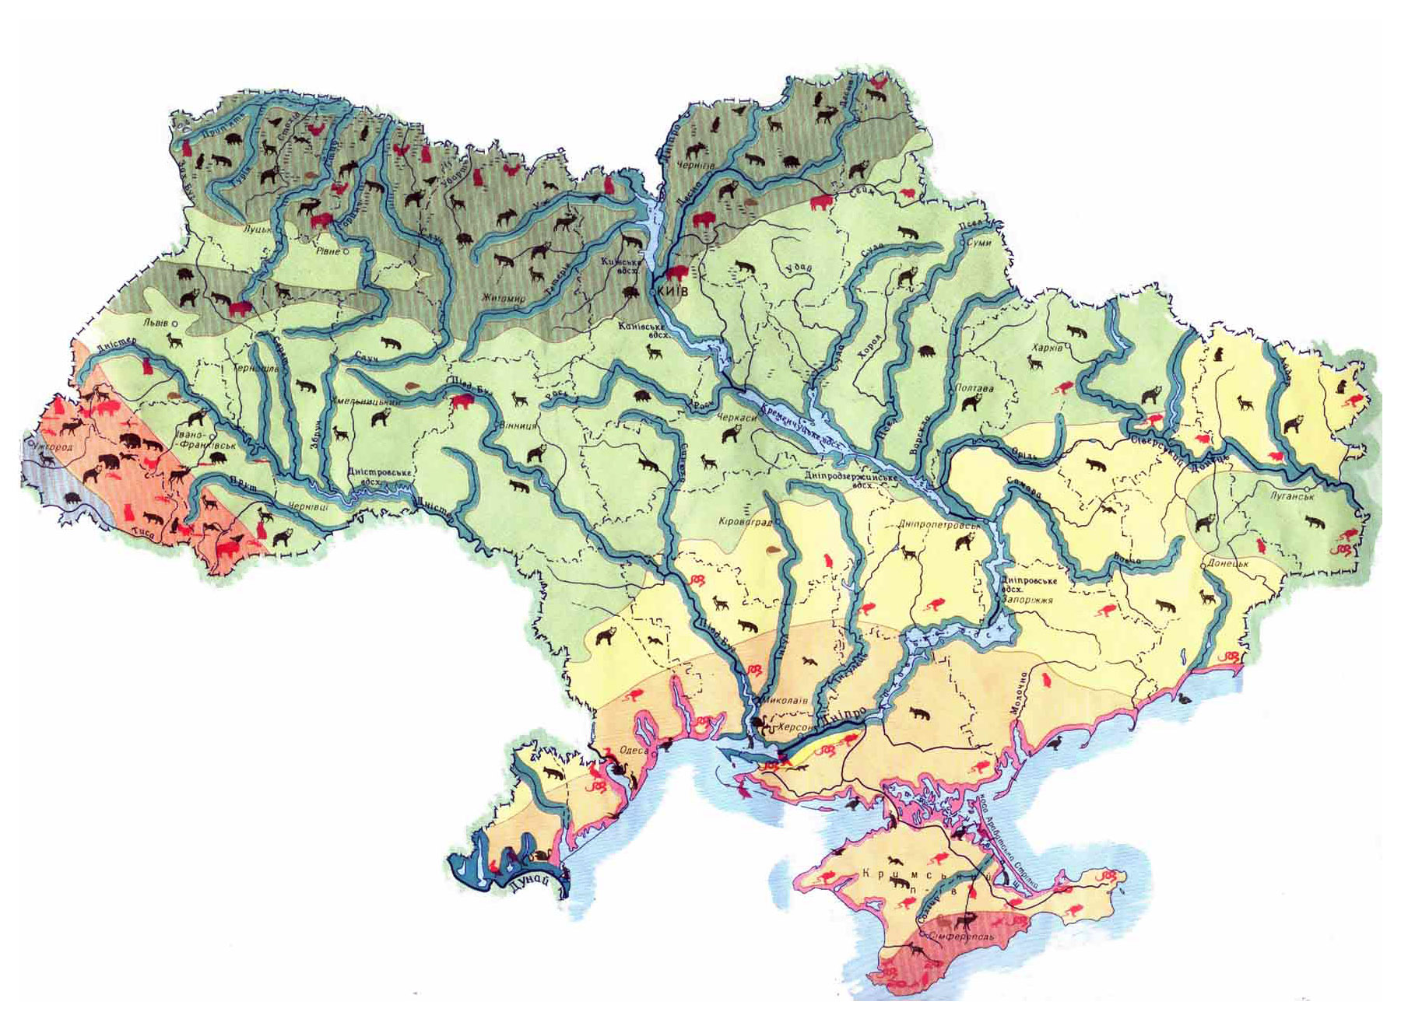
There are 71 thousand rivers on the territory of Ukraine.

Slide 15
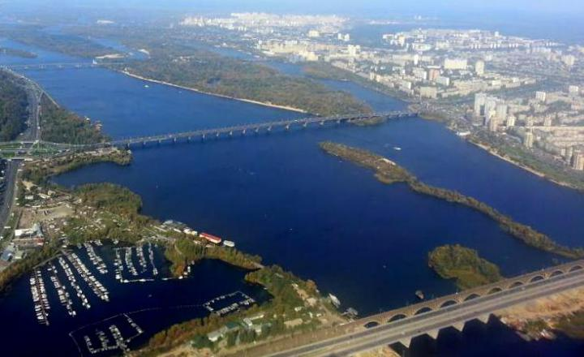
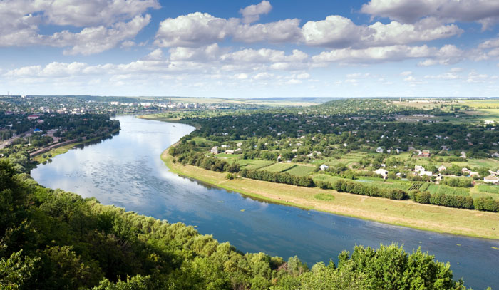
The main rivers of Ukraine
Dnipro
Dniester

Slide 16
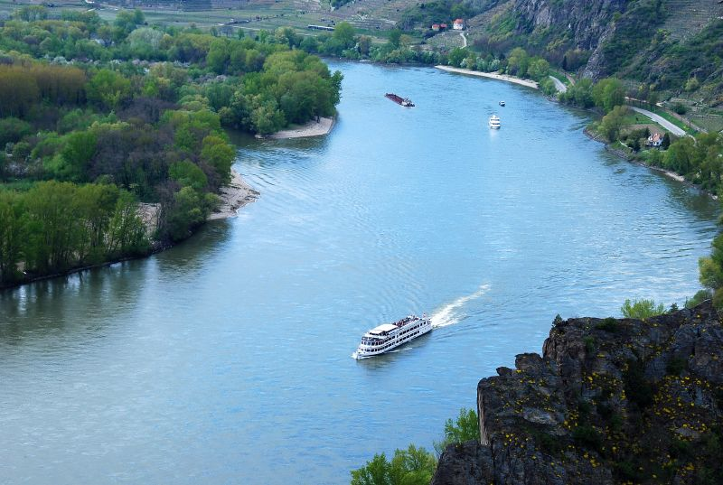
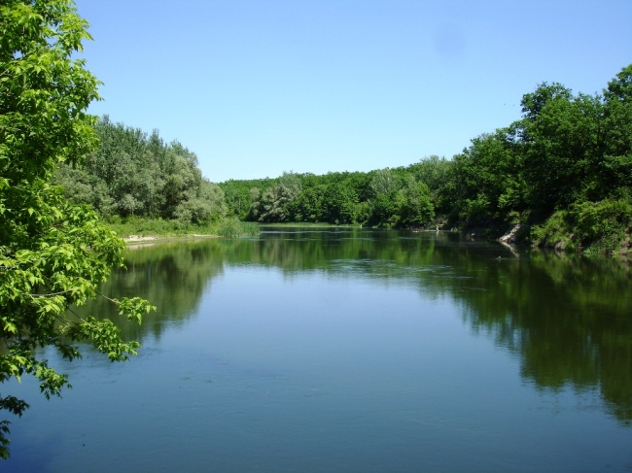
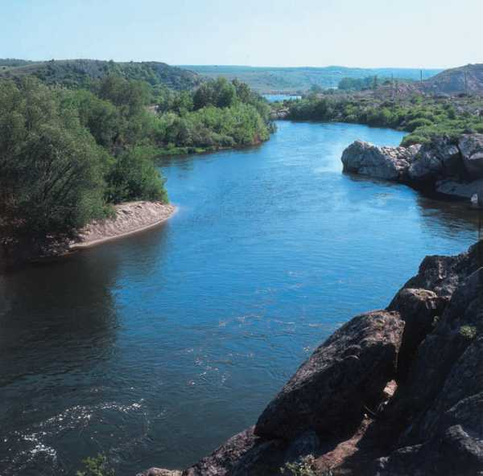
The main rivers of Ukraine
Danube
Seversky Donets
Southern Bug

Slide 17
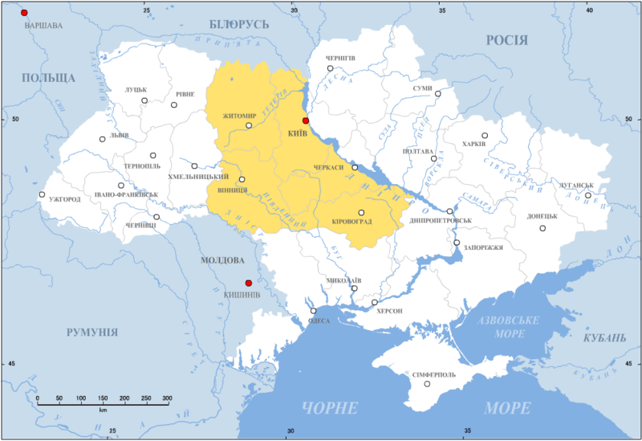
The Dnipro is the main river of Ukraine

Slide 18
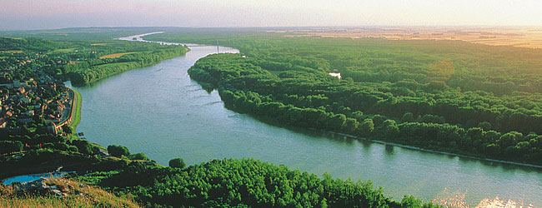
Danube river
The Danube is the second-largest river (after the Volga). The length is 2850 km. It flows through Germany, Austria, Slovakia, Hungary, Croatia, Bulgaria, Romania, and Ukraine.

Slide 19
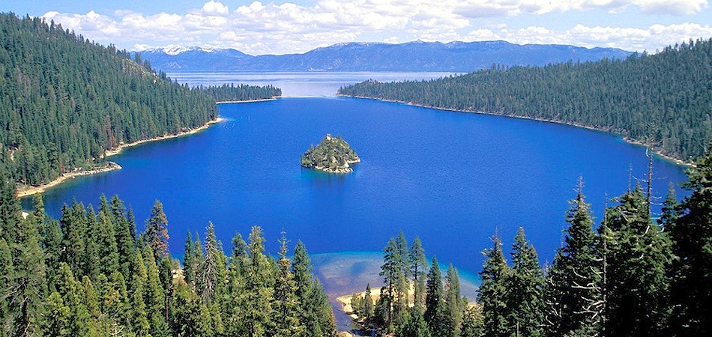
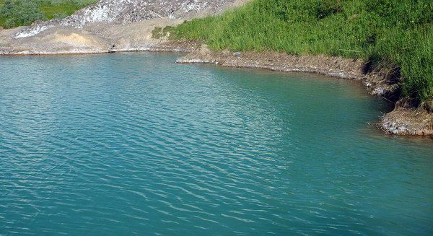
There are more than 3,000 lakes in Ukraine
Synevir lake is the deepest lake. Its area is 700 square meters, and its depth is 20 meters.
Lake Yalpug is the second largest lake in Europe. Its length is 39 km, width up to 5 km, depth - 6 meters.

Slide 20
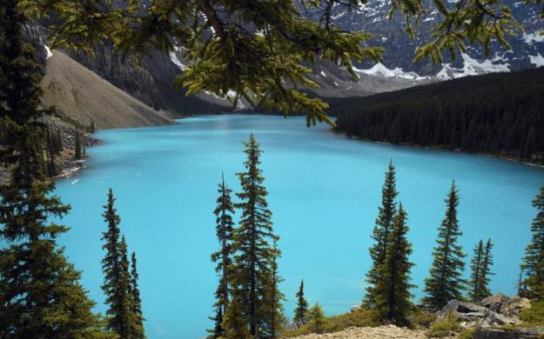
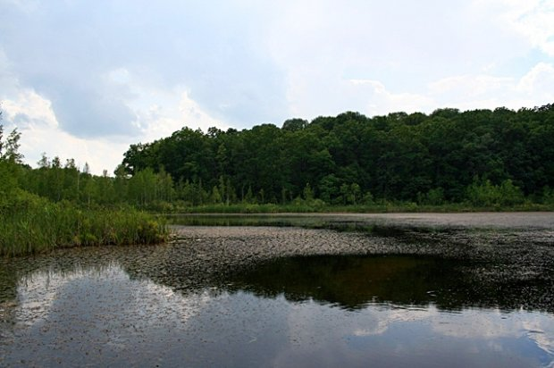
There are more than 3,000 lakes in Ukraine
Blue Lake is located in the Carpathians. The lake is of volcanic origin. Its area is about 2 hectares. The lake is dead.
Black Lake is located in the center of Ukraine. The age of this lake is a million years.

Slide 21
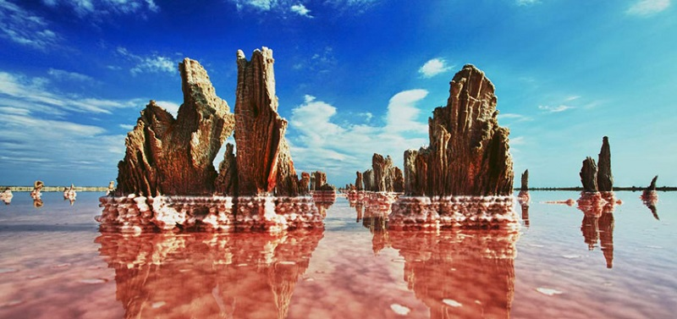
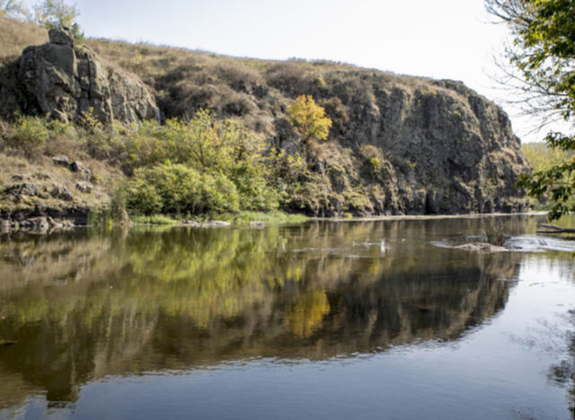
There are more than 3,000 lakes in Ukraine
Koyasky Lake is one of the ten most beautiful lakes in the world. It is located in the South of Ukraine. The saltiest lake in Ukraine. Earlier salt was extracted here.
Soledar Lake is located in eastern Ukraine. Has anomalous properties. At a depth of more than 6 meters, the water looks like liquid glass. Its depth of about 100 meters.

Slide 22
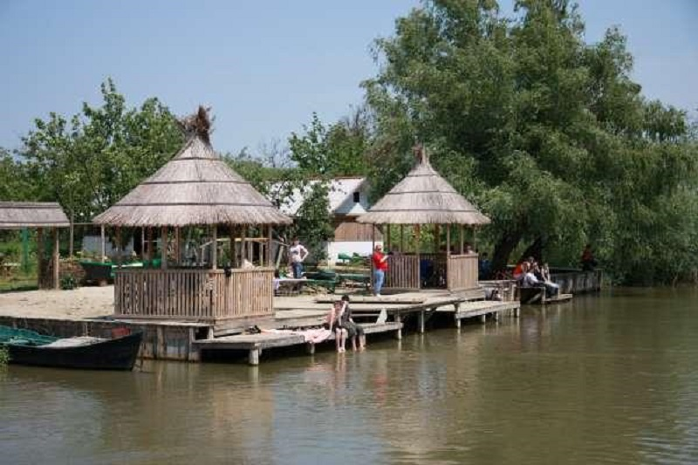
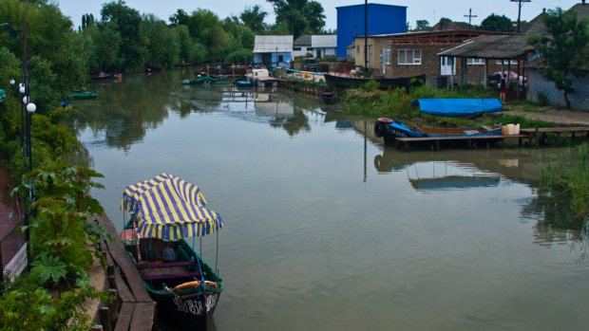
City on the water
In the South of the Odesa region is a small Ukrainian town - Kiliya. The old part of town is located on the water. On these streets, residents move through canals on gondolas and motorboats.

Slide 23
Climate in Ukraine

Slide 24
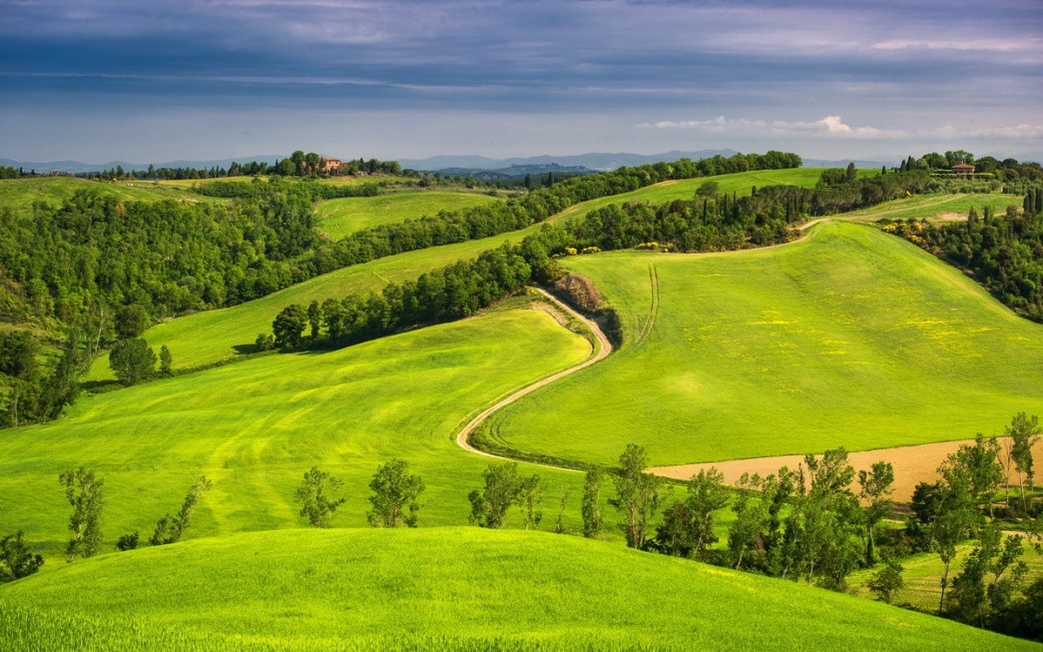
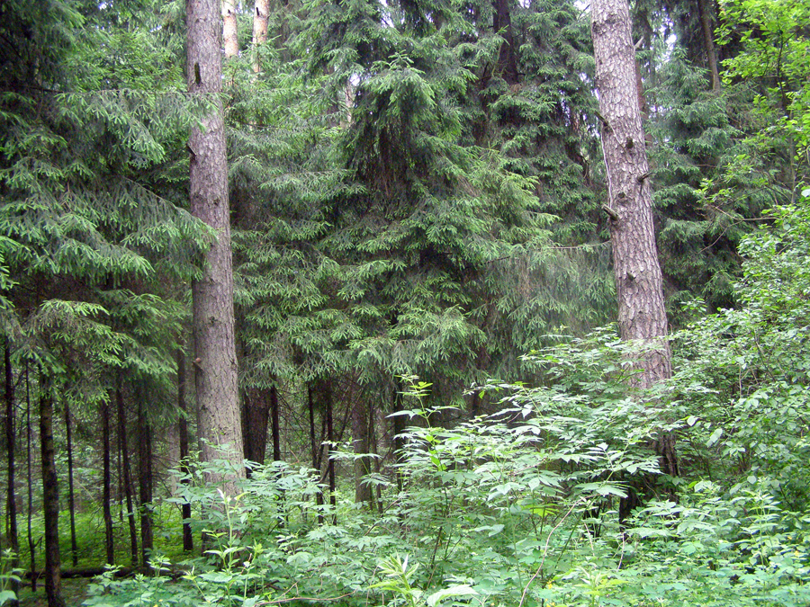
Climate in Ukraine
In most parts of Ukraine, the climate is moderately continental. There are four climatic regions in Ukraine - Northern, Southern, Mediterranean, and Mountain.

Slide 25
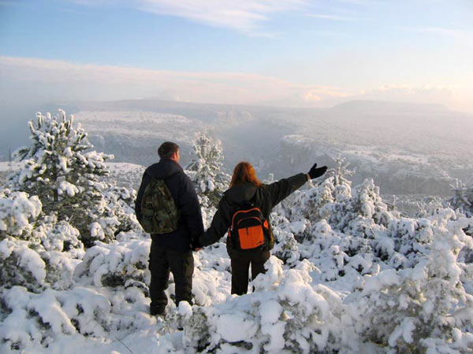
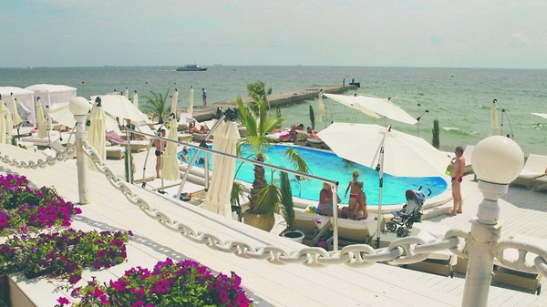
Climate in Ukraine
In the North, the average temperature in January is from −6.5° to −8°С, in July - from +15.5° to +20.5°С.
In the South, the average temperature in January is from −2° to −7°С, in July - from +21.5° to +30°С.

Slide 26
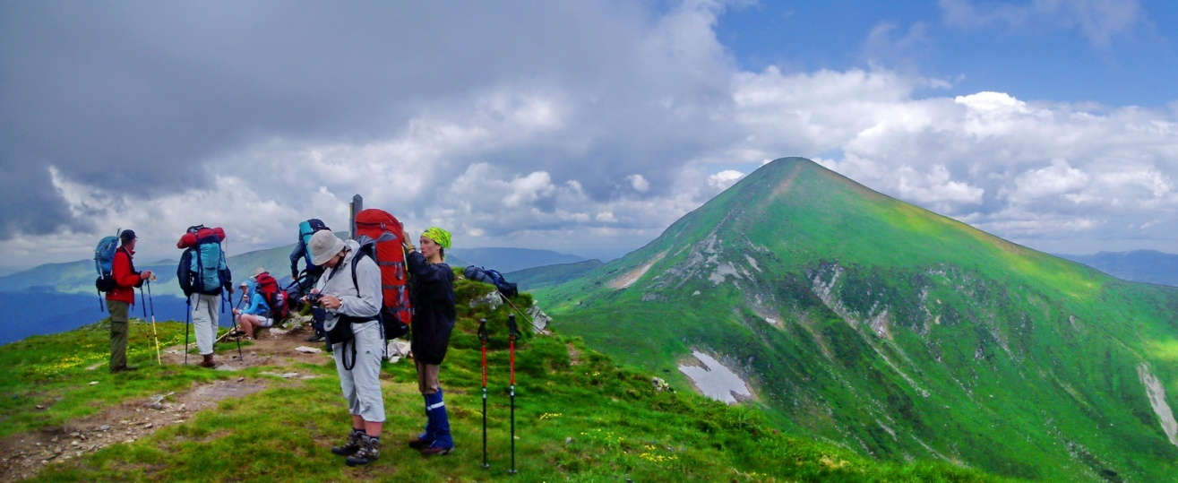
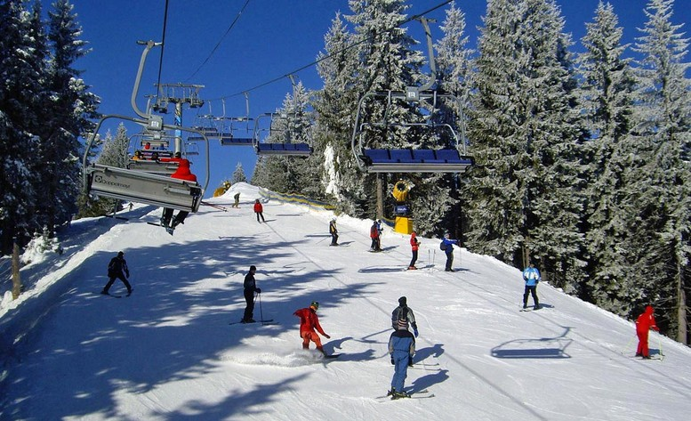
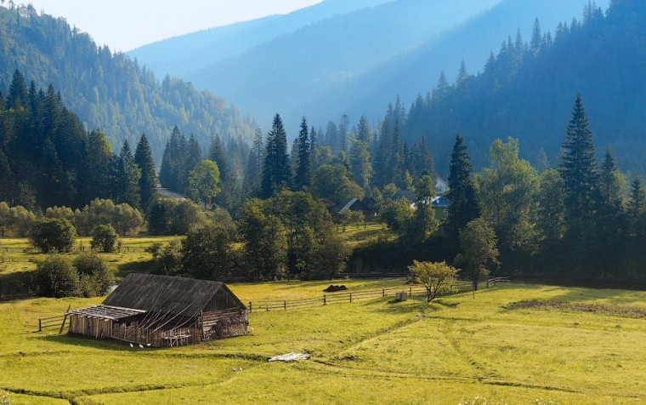
Climate in Ukraine
Mountainous climatic region - Ukrainian Carpathians. The average annual temperature is low: in the Carpathians, it is +4.5°С.

Slide 27
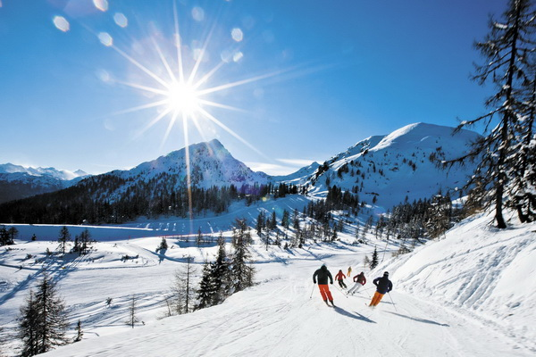
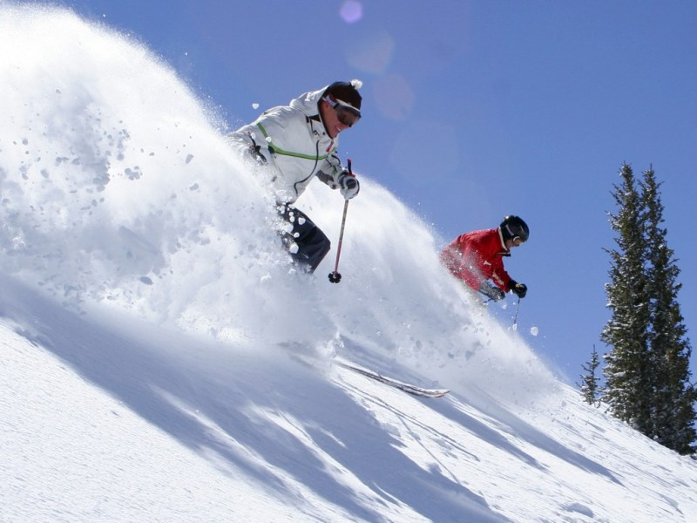
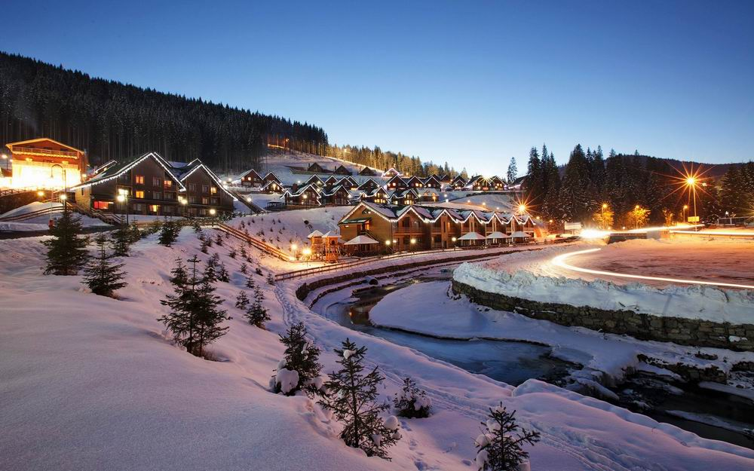
Climate in Ukraine
Winters in the Carpathians are snowy, and snow lies from October to May.

Slide 28
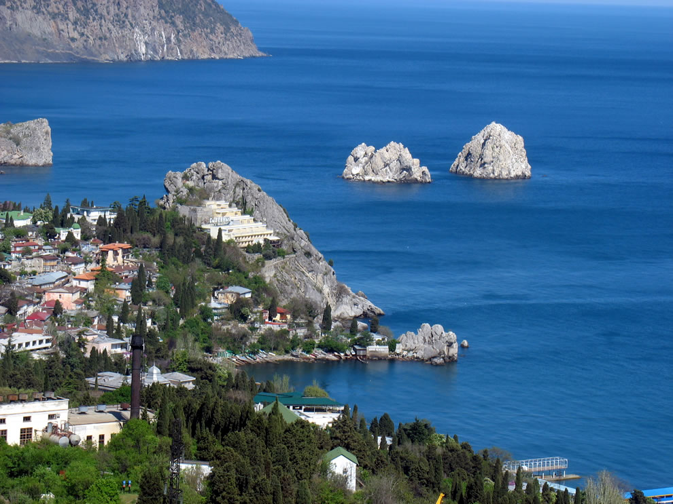
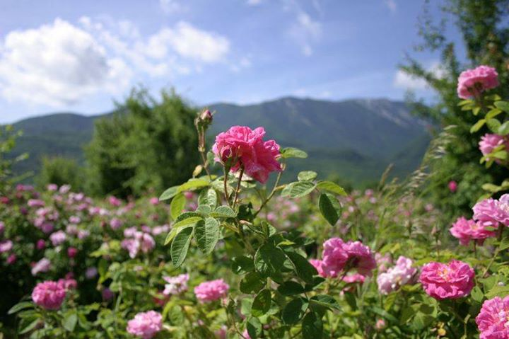
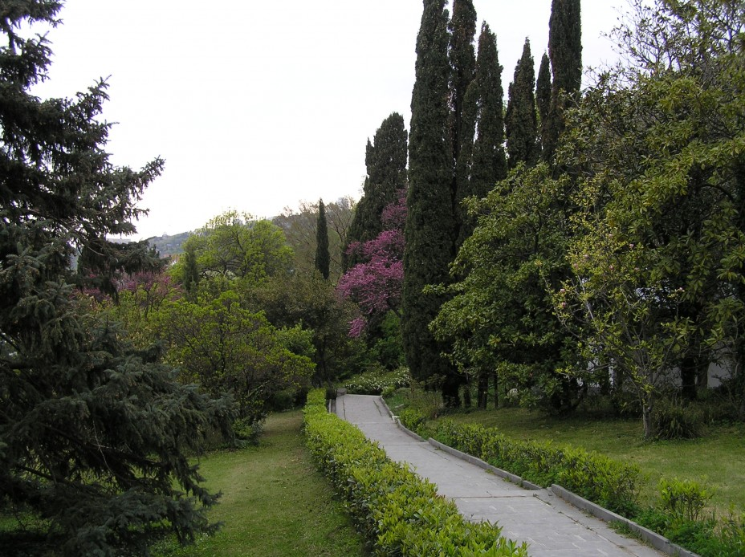
Climate in Ukraine
The climate on the southern coast of Crimea is subtropical.

Slide 29
THANKS
Does anyone have any questions?
Follow Us on Social Media
dec.ipig@opu.ua
opu.ua
fspirki.opu.ua
facebook.com/IPIG.ONPU
Project manager: lebedmy@gmail.com
The presentation was prepared by:
Saveliev A. A., Dean of the Educational Institute of Foreign Citizens Training
Kunitsyn M. V., Deputy Dean of the Educational Institute of Foreign Citizens Training

